Slide 1
Multigroup comparisons
Friday, 16 January 2025

Slide 2

Outline
Multigroup comparisons
ANOVA analysis
R x C analysis
Examples

Slide 3
Multigroup comparisons
Three or more groups or categories; comparing the means
One-way Analysis of Variance (ANOVA)
Parametric (“Normal”)
Kruskal-Wallis rank sum test
Non-parametric (“Non-normal”)

Slide 4
One-way anova
Hypothesis:
H0: No difference in the means between the groups
Ha: There is a difference in the means between the groups
Research question:
Is there a difference between the mean glucose levels across different age categories (20 to 29 years, 30 to 39 years, and 40+ years) in the diabetes.data dataframe?

Slide 5
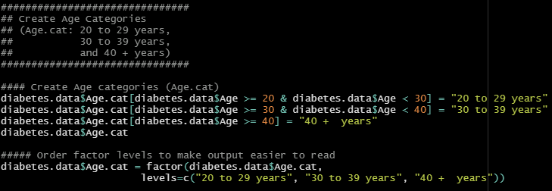
Creating categories in r

Slide 6

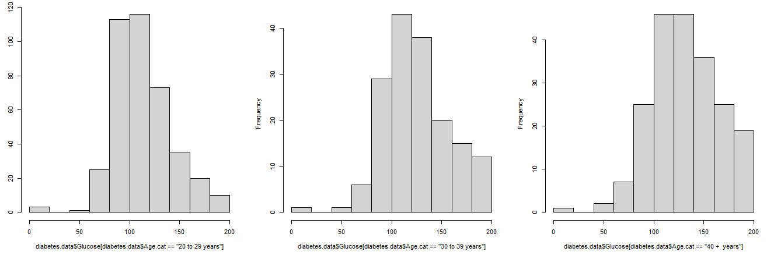
Histogram of glucose levels between age categories

Slide 7

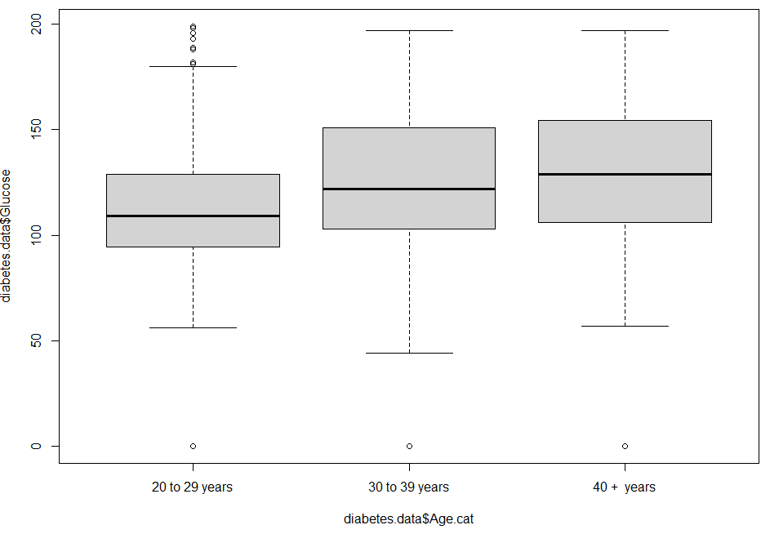
Box plots of glucose levels between age categories

Slide 8

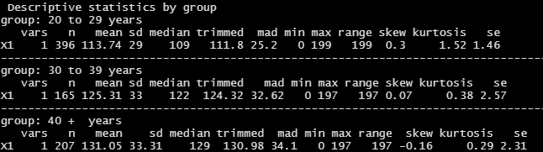
Descriptive analyses

Slide 9
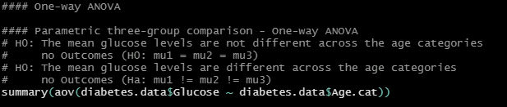

One-way ANOVA
F = 23.19 (2, 765)
P < 0.001

Slide 10

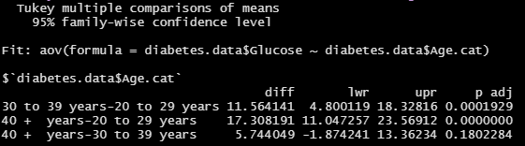
One-way ANOVA – Post hoc test

Slide 11
One-way ANOVA conclusion
There was a difference in the average glucose level between age categories (F = 23.19; df = 2, 765; p < 0.001)
In the post hoc test (Tukey), differences were reported between the “30 to 39 years” and “20 to 29 years” groups (p < 0.001) and the “40 + years” and “20 to 29 years” groups (p < 0.001)
Variable | 20 to 29 years (N = 395) | 30 to 39 years (N = 165) | 40 + years (N = 207) | Test stat (df) | P-value
Glucose (mg/dL), mean (SD) | 113.7 (29.0) | 125.3 (33.0) | 131.1 (33.3) | F = 23.19 (df = 2, 765) | <0.001
P < 0.001
P = 0.180
P < 0.001

Slide 12
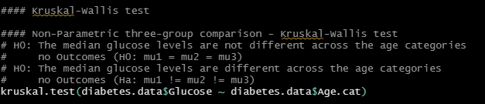

Kruskal-Wallis rank sum test

Slide 13
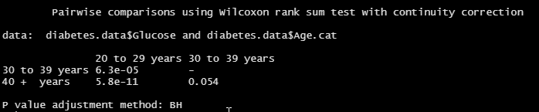
Kruskal-Wallis – Post hoc test

Slide 14
Kruskal-Wallis conclusion
Variable | 20 to 29 years (N = 395) | 30 to 39 years (N = 165) | 40 + years (N = 207) | Test stat (df) | P-value
Glucose (mg/dL), median (min-max) | 109 (0-199) | 122 (0-197) | 129 (0-197) | X2 = 49.45 (df = 2) | <0.001
P < 0.001
P = 0.054
P < 0.001

Slide 15
R x C analysis
Row versus columns
BMI categories | Age (20-29 years) N (%) | Age (30-39 years) N (%) | Age (40+ years) N (%) | Chi2 (df) P-value
<28 kg / m2 | 135 (34.1%) | 39 (23.6%) | 50 (24.2%) | Chi2 = 15.82 (6) P = 0.015
28 to < 32 kg / m2 | 75 (18.9%) | 40 (24.2%) | 34 (16.4%)
32 to < 37 kg / m2 | 96 (24.2%) | 52 (31.5%) | 69 (33.3%)
37 + kg / m2 | 90 (22.7%) | 34 (19.1%) | 54 (26.1%)

Slide 16
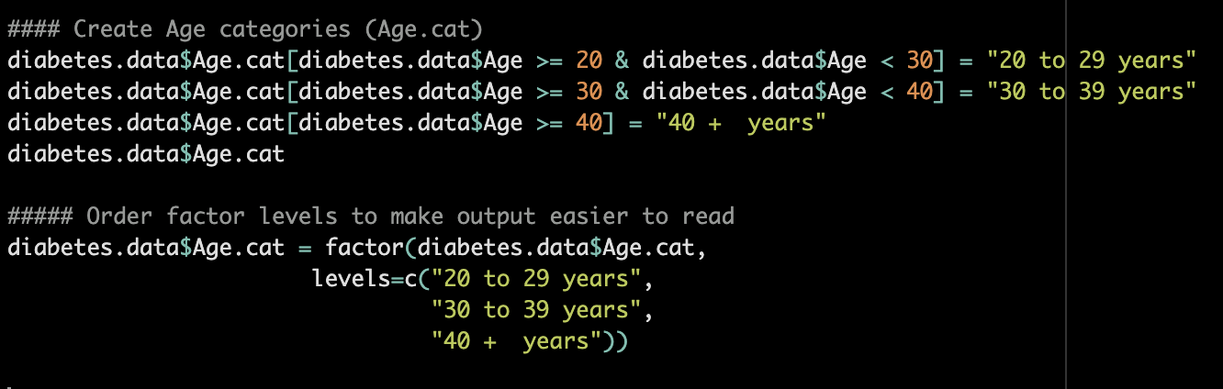
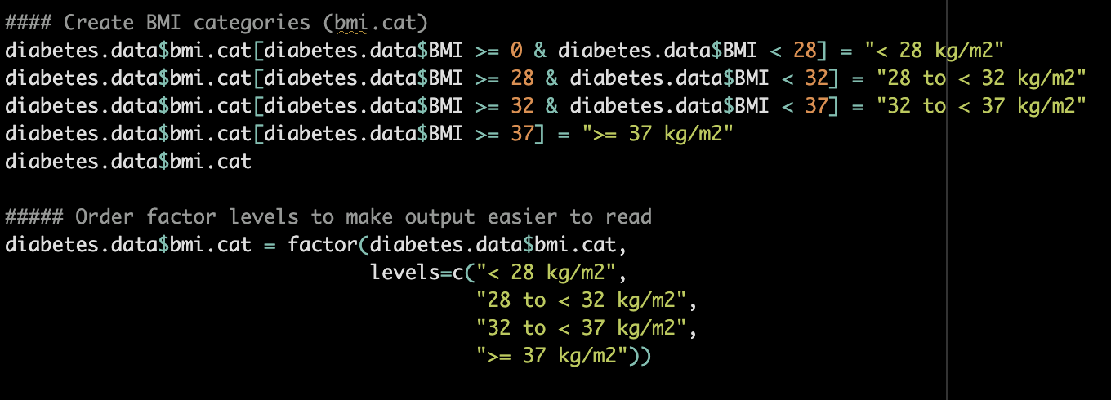
R x C analysis in r
Create BMI and Age categories

Slide 17
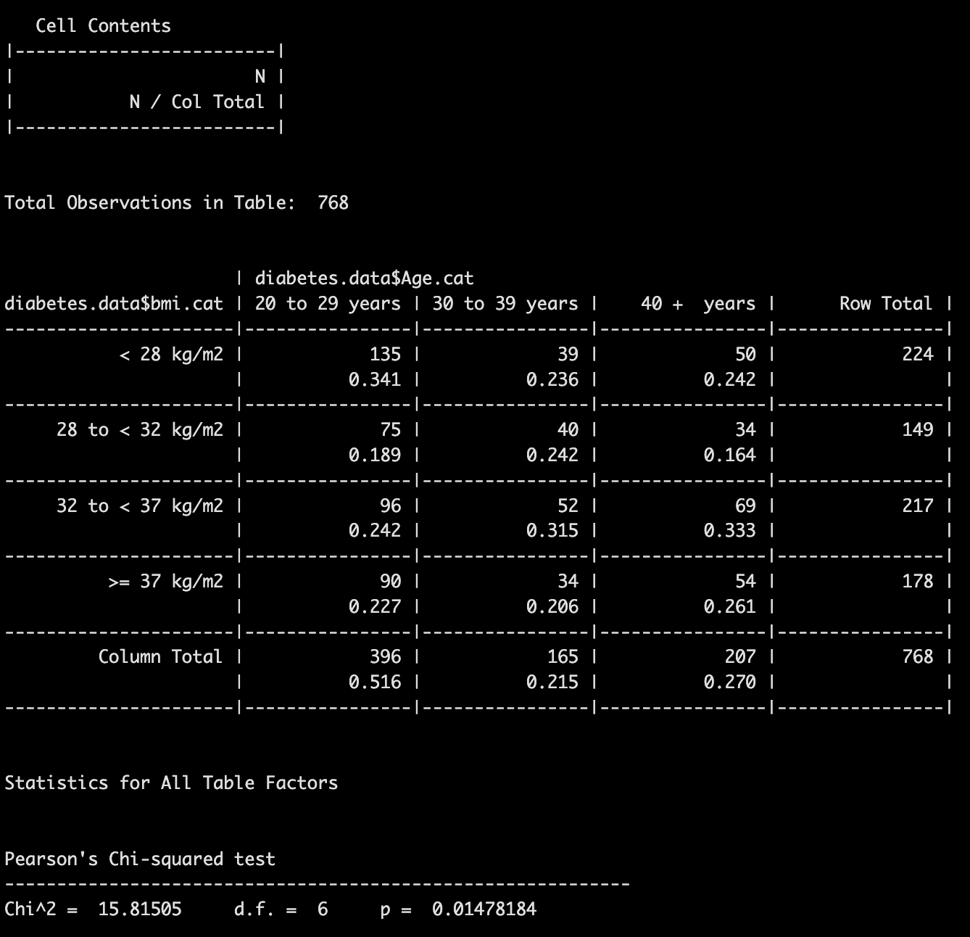
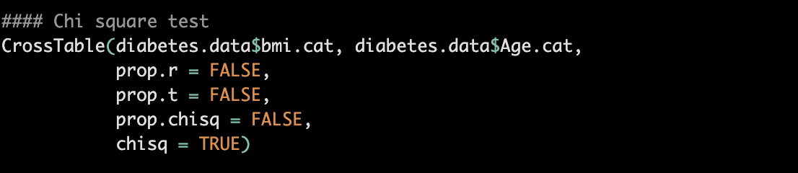
R x C analysis in r
CrossTable()

Slide 18
conclusions
One-way ANOVA is used for continuous data that are parametric for multigroup comparisons
Kruskal-Wallis is used for continuous data that are non-parametric for multigroup comparisons
R x C analysis allows you to make comparisons with three or more categories

Slide 19

LINKS AND RESOURCES
R tutorial on one-way ANOVA

